Slide 1
Information Extraction Google Cloud Natural Language API and QuickCode
Pan Chen
NLP Application Area Investigations
Ist664
Fall 2017

Slide 2
What is Information Extraction?
Information extraction is the process of extracting specific information from various textual sources, and returns the information we wanted in a format that we wanted.
How it contribute to NLP field:
With the data structured in the
ways we want, we can run various
kinds of NLP analyses on those data.
Source: https://ontotext.com/knowledgehub/fundamentals/information-extraction/

Slide 3
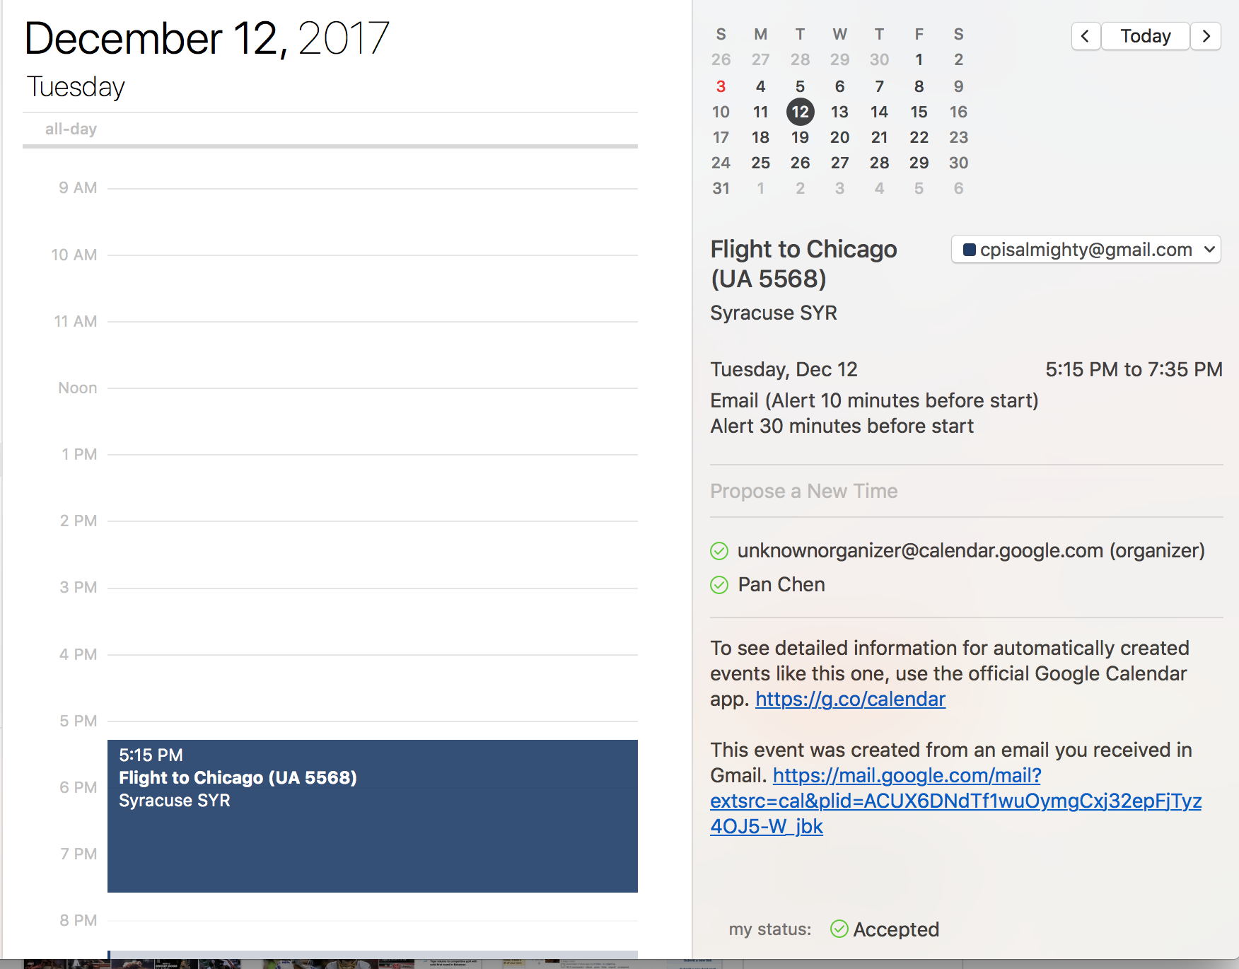
IE: Simple example
One of the most trivial examples: when your email extracts only the data from the message for you to add in your Calendar.
My flight is automatically added to my calendar
once I booked the flight on United and they sent
me a confirmation email to my gmail
So let’s take a look at one application that
utilizes Google’s IE technology

Slide 4

Google: CLOUD NATURAL LANGUAGE API
What it does:
Information extraction: It reveals the structure and meaning of text by offering powerful machine learning models in an easy to use REST API. You can use it to extract information about people, places, events and much more, mentioned in text documents, news articles or blog posts.
Sentiment Analysis: It also analyzes sentiment about your product on social media or parse intent from customer conversations happening in a call center or a messaging app.
Multi-language support
Source: https://cloud.google.com/natural-language/

Slide 5
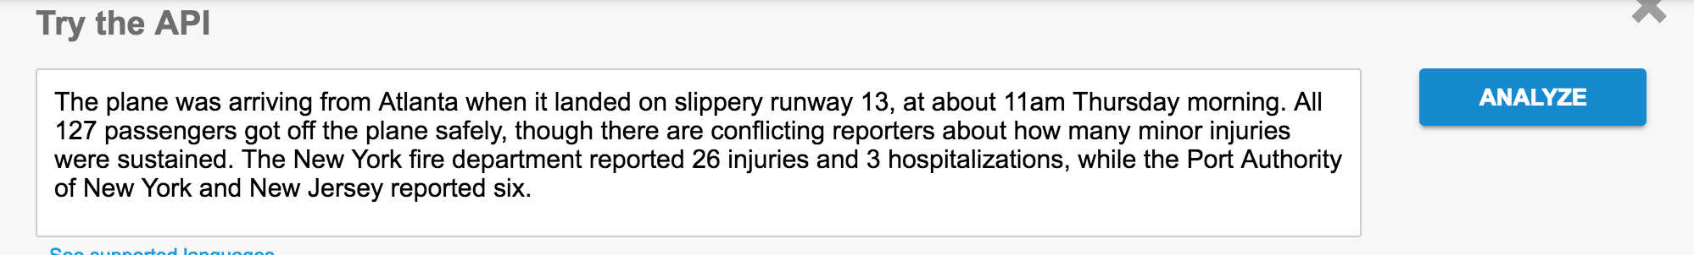
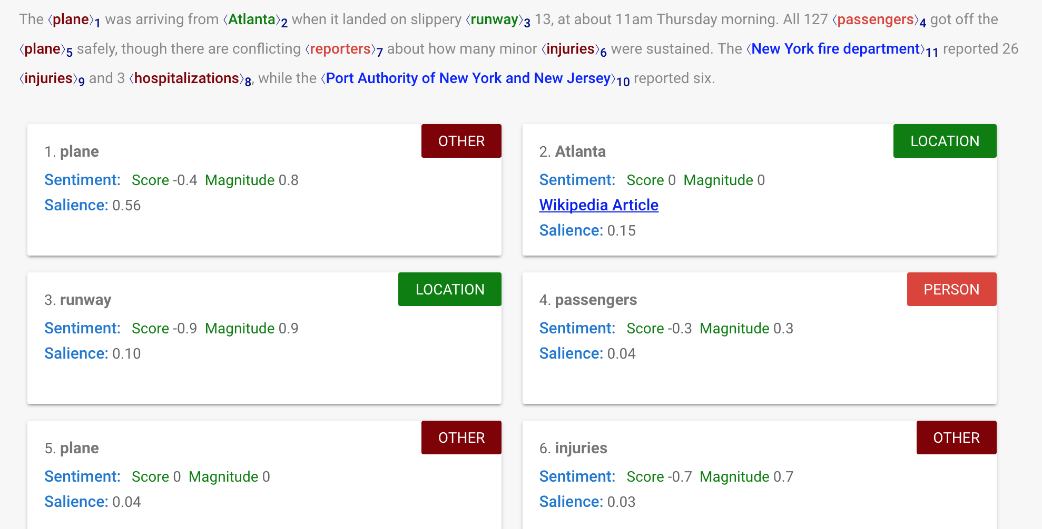
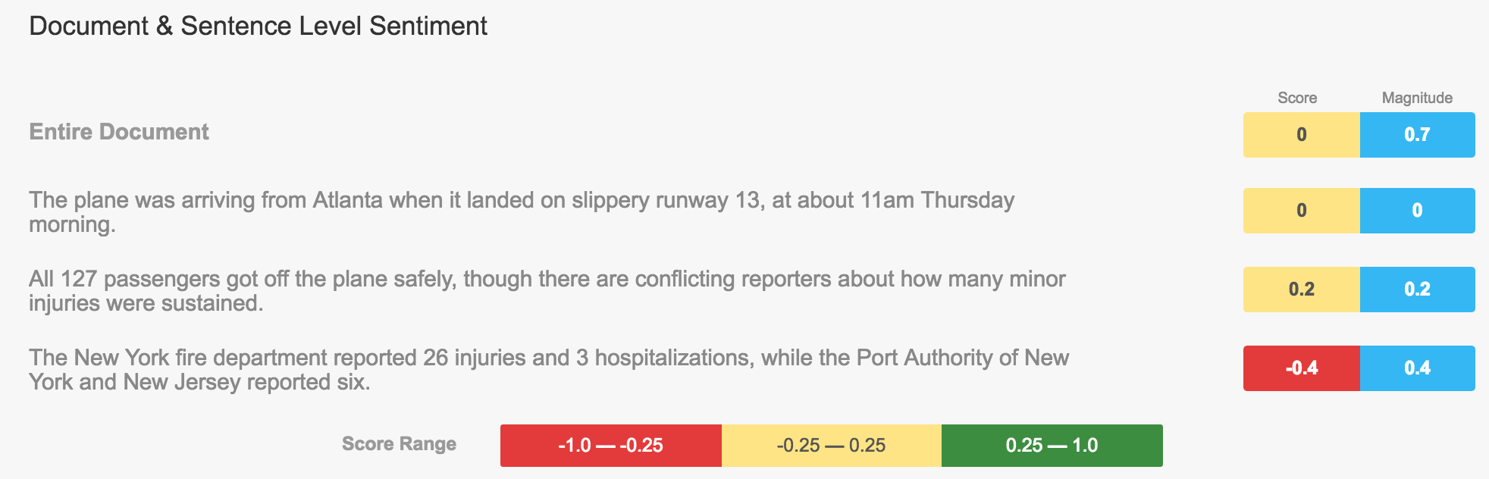
Try it out:
Information Extraction:
Sentiment Analysis

Slide 6
Cons
Pros
It returns results very fast
Toolkits stored on the cloud
Could be easily incorporated in various popular coding languages via RESTful API
Could be utilized alongside other Google Cloud Tools including Cloud SQL (for data storage), Vision API (for image content) analysis
Costs $$$
Hard to tune the parameters to return a customized results
Not open-sourced like Stanford's Core NLP Suite and the example I am going to introduce later

Slide 7
A Lesser-known IE Product: QuickCode from The Sensible Code Company
QuickCode (formerly ScraperWiki) is a web-based platform for collaboratively building programs to extract and analyze public (online) data, in a wiki-like fashion.
"Scraper" refers to screen scrapers, programs that extract data from websites. "Wiki" means that any user with programming experience can create or edit such programs for extracting new data, or for analyzing existing datasets
Target: providing a place for programmers and journalists to collaborate on analyzing public data

Slide 8
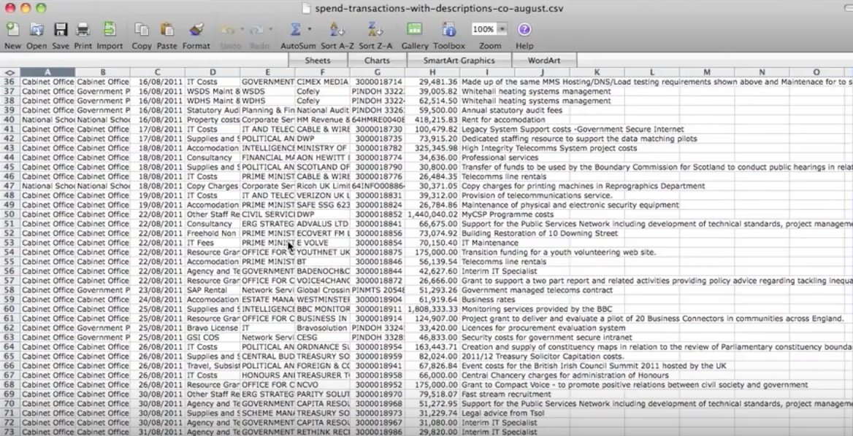
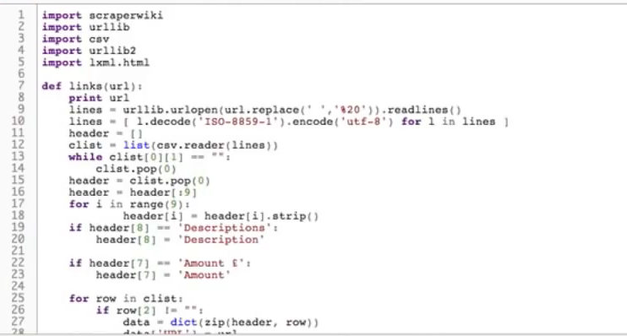
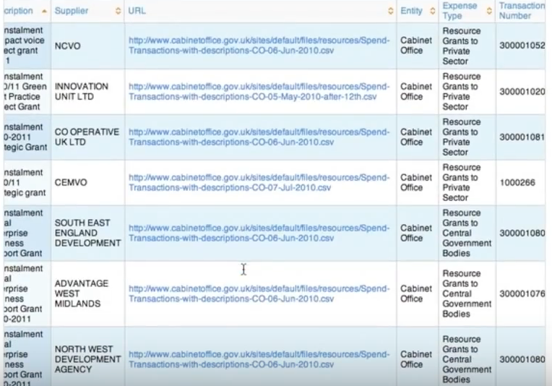
Unstructured text data→ using ScraperWiki->StructuredData

Slide 9
QuickCode is open source and free!
Check it out at: https://github.com/sensiblecodeio/custard

Slide 10
Thank you!

Slide 11
Reference and Resources
https://cloud.google.com/natural-language/
https://www.youtube.com/watch?v=bCfioOzb3Xg (Introduction to ScraperWiki Video)
https://quickcode.io/ (QuickCode company website)
https://github.com/sensiblecodeio/custard (QuickCode Github)

